Slide 1
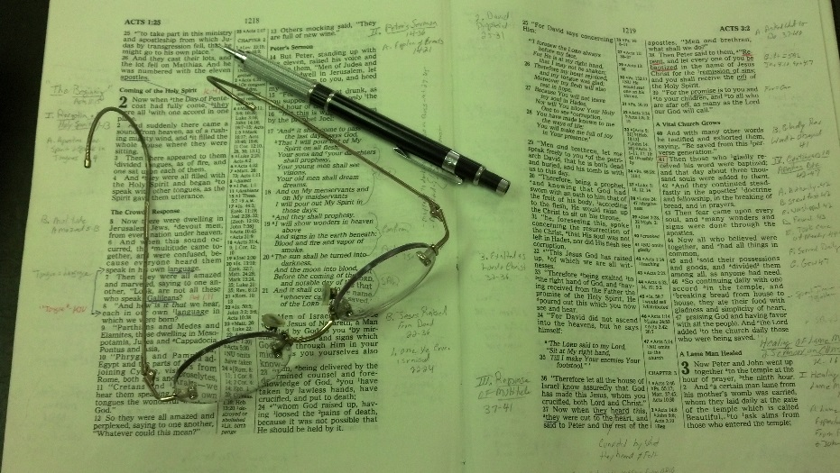
Topics
Monday: Is One Faith as Good as Another?
Tuesday: Things that Encourage
Wednesday: The Peace of God
Thursday: Settled in Complacency
Friday: The Earnest Cry of Bartimaeus

Slide 2
Mark 9:14-29
Healing of Epileptic Son
(Matt. 17:14-21; Luke 9:37-42)
Setting (vv. 14-16)
Jesus & 3 disciples come down from mt. of transfig. (vv. 2-13)
Large crowd & disputing (vv. 14-16)

Slide 3
Mark 9:14-29
Healing of Epileptic Son
(Matt. 17:14-21; Luke 9:37-42)
Setting (vv. 14-16)
Problem (vv. 17-18) – Father of epileptic explains:
Son has an evil spirit (vv. 17-18)
Disciples failed (v. 18)
Had to be a “set back” for the father

Slide 4
Mark 9:14-29
Healing of Epileptic Son
(Matt. 17:14-21; Luke 9:37-42)
Setting (vv. 14-16)
Problem (vv. 17-18) – Father of epileptic explains:
Jesus’ Response (vv. 19-29)
Rebuked Jews and scribes for unbelief (v. 19)
Son brought to Jesus (vv. 20-22a)
Father expresses doubt (vv. 22b-23)
Father cries out for help (v. 24)
Son healed (vv. 25-27)
Explains to disciples why they failed (vv. 28-29; Mt. 17:20)

Slide 5
Mark 9:14-29
Healing of Epileptic Son
(Matt. 17:14-21; Luke 9:37-42)
Setting (vv. 14-16)
Problem (vv. 17-18) – Father of epileptic explains:
Jesus’ Response (vv. 19-29)
Story of faith and doubt
Broad statement to Jews - faithless (v. 19)
Intended for the Jews & scribes
Must have thought of his own disciples
Father expressed doubt – “if” (v. 22)
“Half doubting, half in despair” (Pulpit)
While referring to Jesus – pointing to failure of the disciples

Slide 6
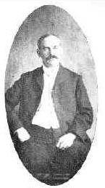
When he qualifies his petition with the clause: “if thou art able in any way,” we should remember the setback his faith received when the nine disciples of Jesus failed to accomplish anything; this “if” refers to that failure.
Lenski, R. C. H. (1961). The Interpretation of St. Mark’s Gospel (p. 380)

Slide 7
Mark 9:14-29
Healing of Epileptic Son
(Matt. 17:14-21; Luke 9:37-42)
Setting (vv. 14-16)
Problem (vv. 17-18) – Father of epileptic explains:
Jesus’ Response (vv. 19-29)
Story of faith and doubt
Broad statement to Jews - faithless (v. 19)
Father expressed doubt – “if” (v. 22)
Disciples told the problem is lack of faith (Matt. 17:20)

Slide 8
Mark 9:14-29
Healing of Epileptic Son
(Matt. 17:14-21; Luke 9:37-42)
Setting (vv. 14-16)
Problem (vv. 17-18) – Father of epileptic explains:
Jesus’ Response (vv. 19-29)
Story of faith and doubt
V. 24: “help my unbelief”
Paradoxical phrasing: “I believe, help my unbelief”
Claims to have faith – but recognizes his weakness
Had faith, but he craved even more (A. T. Robertson)
Translations:
NLT: “help me overcome my unbelief”
AMP: “help my weakness of faith”
LBP: “I do have faith, oh help me to have more”

Slide 9
Mark 9:14-29
Healing of Epileptic Son
(Matt. 17:14-21; Luke 9:37-42)
The Point:
Must recognize what is lacking in order to fill the void!
“This, too, was well, for they who feel their lack of faith are in the best condition for removing this lack”
Lenski, R. C. H. (1961). The Interpretation of St. Mark’s Gospel (p. 381)

Slide 10
Help
My
Unbelief
Mark 9:24

Slide 11
Help
My
Unbelief
Help me Have Stronger Faith
Mark 9:24

Slide 12
Help me Have Stronger Faith
Possible to have faith – yet not as strong as should be
Little faith (Matt. 6:30; 8:26)
Fail (Luke 22:32)
Weak (Rom. 4:19)

Slide 13
Help me Have Stronger Faith
Possible to have faith – yet not as strong as should be
The faith you have can be shaken
Because of pressure (1 Thess. 3:3)
Because of error (2 Thess. 2:2)
Because of neglect (Heb. 2:3; 5:12-13)
Because of the failure of others (Mark 9:22)

Slide 14
“Originally he had come seeking for Jesus himself. Since Jesus was on the mountain top, he had had to deal with the disciples, and his experience of them was discouraging. His faith was badly shaken, so badly shaken that when he came to Jesus all he could say at first was, ‘Help me, if you can.’ Then, face to face with Jesus, suddenly his faith blazed up again. ‘I believe,’ he cried.”
Barclay, W. (2001). The New Daily Study Bible: The Gospel of Mark (p. 253). Edinburgh: Saint Andrew Press.

Slide 15
“It sometimes happens that people get less than they hoped for from some church or from some servant of the Church. When that happens, they ought to press beyond the Church to the Master of the Church, beyond the servant of Christ to Christ himself. The Church may at times disappoint us, and God’s servants on earth may disappoint us. But when we battle our way face to face with Jesus Christ, he never disappoints us.”
Barclay, W. (2001). The New Daily Study Bible: The Gospel of Mark (p. 253).

Slide 16
Help me Have Stronger Faith
Possible to have faith – yet not as strong as should be
The faith you have can be shaken
Faith is strengthened through the word
Faith is built, strengthened & maintained by the word (Rom. 10:17)
Built up by the word (Acts 20:32)
Don’t expect your faith to get any stronger when:
Read little in the word
Spend more time reading & listen to things about the word

Slide 17
Help me Have Stronger Faith
Possible to have faith – yet not as strong as should be
The faith you have can be shaken
Faith is strengthened through the word
The goal – to have faith that fully trust
The father didn’t fully trust (v. 22)
Jesus calls for him to fully trust (v. 23)
Disciples didn’t fully trust (Matt. 17:20)
Faith described by prayer & fasting (v. 29)
Prayer – faith that trust God to respond (Lk. 18:1)
Fasting – faith that God will help & provide

Slide 18
Help
My
Unbelief
Help me Have Stronger Faith
Help me Settle my Doubts
Mark 9:24

Slide 19
Help me Settle my Doubts
Father had doubts
“If” suggests a question in his mind
Not saying, “I don’t believe you can” – but has questions
Perhaps had good reason – disciples’ failure led him to question
His request: help me with my doubts!

Slide 20
Help me Settle my Doubts
Father had doubts
Times we have doubts – even though we have faith
Peter did (Matt. 14:31)
Disciples had doubts when thy saw what they couldn’t explain (Luke 24:38)
We too will have questions and doubts

Slide 21
Help me Settle my Doubts
Father had doubts
Times we have doubts – even though we have faith
Doubts can be and must be settled
The father cried for help with his doubts
Bereans studied and settled their questions and doubts (Acts 17:11)

Slide 22
Help
My
Unbelief
Help me Have Stronger Faith
Help me Settle my Doubts
Help my Disobedience
Mark 9:24

Slide 23
Help my Disobedience
Disobedience is unbelief
When Moses disobeyed – God said he did not believe (Num. 20:12)
Disobedience is following own will and not God’s
Faith involves listening and obeying (Heb. 11:4, 7)

Slide 24
Help my Disobedience
Disobedience is unbelief
Every act of disobedience is a crack in our faith
Do what God said not do (Jas. 2:9)
Neglect to do what God told us to do (Jas. 4:17)

Slide 25
Help my Disobedience
Disobedience is unbelief
Every act of disobedience is a crack in our faith
Help me to be stronger in faith and more obedient
Grow in favor – more pleasing (2 Pet. 3:18)
Mature in the faith (Phil. 3:15)

Slide 26
Help
My
Unbelief
Help me Have Stronger Faith
Help me Settle my Doubts
Help my Disobedience
Help my Rejection of Word
Mark 9:24

Slide 27
Help my Rejection of Word
Possible to have faith & yet reject the word
Zecharias was a righteous man – thus, he had faith (Luke 1:6)
Yet, when given the word from God, didn’t believe it (Luke 1:20)
Knew & understood what was said – just didn’t believe it
Reason: Did not fit human reasoning – couldn’t be!

Slide 28
Help my Rejection of Word
Possible to have faith & yet reject the word
May be times we have a hard time believing God
Baptism (Mark 16:16)
Disobedient lost (2 Thess. 1:7-9)
Hell (Mark 9:43)
God created world instantly (Psa. 33:6-9)
Jonah swallowed by fish (Jonah 1:17)
Serpent spoke to Eve (Gen. 3)

Slide 29
Help my Rejection of Word
Possible to have faith & yet reject the word
May be times we have a hard time believing God
Help me with my lack of confidence in the word
Help me to believe what God says
Help me be like Abraham (Rom. 4:17-21)

Slide 30
Help
My
Unbelief
Help me Have Stronger Faith
Help me Settle my Doubts
Help my Disobedience
Help my Rejection of Word
Help me When I Fail to Use the Faith I Have
Mark 9:24

Slide 31
Help me When I Fail to Use the Faith I Have
Disciples had faith – but didn’t use what had
Matt. 17:20
Luke 17:1-10

Slide 32
Help me When I Fail to Use the Faith I Have
Disciples had faith – but didn’t use what had
Not always a matter of how much faith we have – but using the faith we have – to do what we know
Forgiving
Study
Attend
Be mate should be
Be kind
Teach others
Your faith may be lacking…
BUT
You have enough faith to do better than you are!

Slide 33
Help me When I Fail to Use the Faith I Have
Disciples had faith – but didn’t use what had
Not always a matter of how much faith we have – but using the faith we have – to do what we know
Anytime I fail to do what I really know I should – I fail to use the faith I have

Slide 34
Help
My
Unbelief
Help me Have Stronger Faith
Help me Settle my Doubts
Help my Disobedience
Help my Rejection of Word
Help me When I Fail to Use the Faith I Have
Help me in the Midst of Emotional Turmoil
Mark 9:24

Slide 35
Help me in the Midst of Emotional Turmoil
The father was frustrated with emotional turmoil over his son (v. 24)
Emotional turmoil could plague any of us at any given moment
“No one is characterized by a ‘red-hot’ faith around the clock.” (Wayne Jackson)
Death (own impending or family)
Family stress
Job pressure
Sickness
Concern for others

Slide 36
Help me in the Midst of Emotional Turmoil
The father was frustrated with emotional turmoil over his son (v.24)
Emotional turmoil could plague any of us at any given moment
When under emotional turmoil – can still have faith – yet struggle
Job did (19:25; 6:3-4)
Father did (Mark 9:24)

Slide 37
Be that as it may, sometimes, when we are hurting so badly (and pain can generate confusion), our hearts may overpower our heads. By that we mean this: our agony forces clear logic to the side, and we begin to “think” with our feelings. We still believe, but we are angry. We feel neglected; we don’t understand why the Lord doesn’t rush to our beckon call. Sometimes we pout. We refuse to talk to him (i.e., we don’t pray). We think we will punish him by refusing to assemble with other Christians for worship. We may even say harsh and thoughtless things to him, almost literally shaking our fist in his face.
Wayne Jackson
Notes:
https://www.christiancourier.com/articles/36-help-my-unbelief

Slide 38
At times like these we need to get hold of ourselves and give ourselves a good shaking. We need to cry out, “Lord, help my unbelief!” We need to ask for his patience. We need to weep before him. We ought to analyze our situation and attempt to determine if we have contributed to our own problems; and if so, is there anything we can do to help remedy the circumstance. What we absolutely must not do is give in to our frustration. Once we cease struggling with our faith, and let it slide, we are headed down a slippery slope that may lead to eternal ruin. What a horrible thought to contemplate. Lord, I believe; but help me in my times of unbelief!
Wayne Jackson
Notes:
https://www.christiancourier.com/articles/36-help-my-unbelief

Slide 39
Help
My
Unbelief
Help me Have Stronger Faith
Help me Settle my Doubts
Help my Disobedience
Help my Rejection of Word
Help me When I Fail to Use the Faith I Have
Help me in the Midst of Emotional Turmoil
Mark 9:24

